Slide 1
Prediction of Loan Default
By: Ali Nemati
June, 8 2022
The Northwestern Mutual Life – Milwaukee, WI

Slide 2
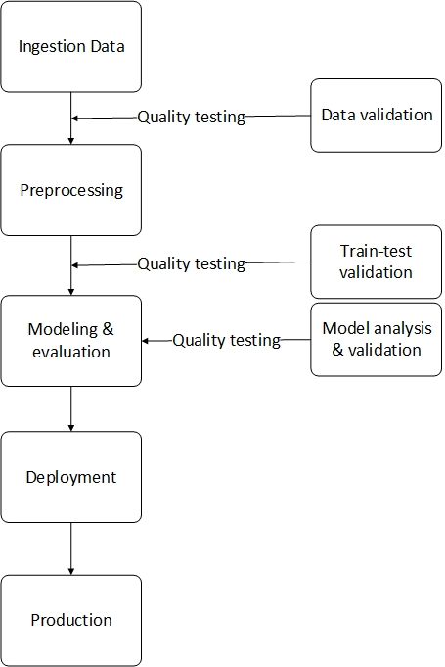


Overview Collaboration
Between
Ml Engineer and
Quality Assurance

Slide 3
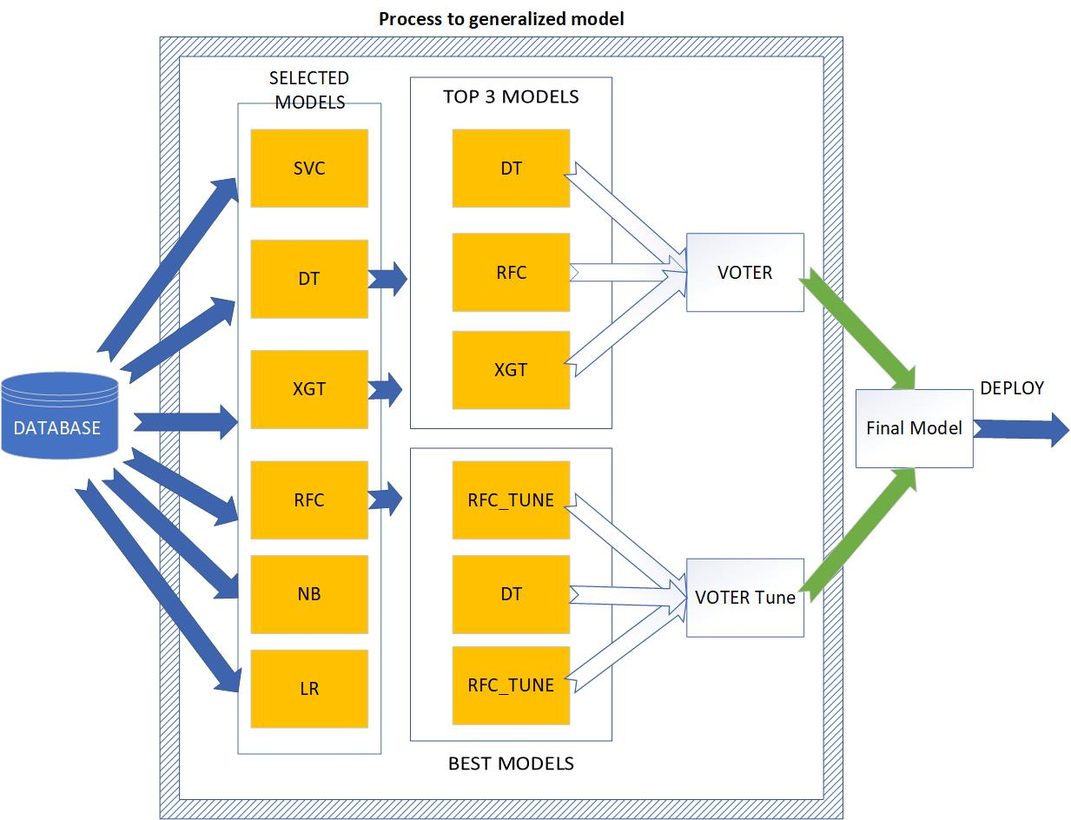
Processing of generalizing the model in the traditional machine learning model

Slide 4
Artificial Neural Network
ANN Model
Model with applying L2 (Ridge ) and Dropout
Model with applying L1 (Lasso) and Dropout
EarlyStopping
Time-based decay
BatchNormalization L2
Final decision

Slide 5
Data Exploration ML Engineer
The present column has a categorical value and numerical
Display Missing value
To identify outliers
To determine if the target is imbalanced or NOT
Other data sanity and visualization
Submission to Quality Assurance

Slide 6
Quality Assurance: (DeepCheck)
Columns Info : it shows information of columns
Conflicting Labels: samples which have the exact same features' values but different labels.
Data Duplicates: Checks for duplicate samples in the dataset.
Feature Label Correlation: the Predictive Power Score of all features in relation to the label.
A score of 0 means that the column x cannot predict target better than a naive base model.
Is Single Value : do we have single value in two column
Mixed Data Types : Do we have a column with string and numerical
Outlier Sample Detection : find outlier
Mixed Nulls : do we have null value?
Ordinary least squares: p-value, standard error, and other statistical value
Correlation(R^2) and show heatmap and pair plot

Slide 7
Preprocessing by ML Engineer
Dealing with missing value
1- Categorical -> replace by mode
2- Numerical -> KNNImputer , k=5
Transform feature -> MinMaxScaler
Split the data 80% training and 20% testing
Dealing with the imbalanced dataset problem :
SMOTE ( SMOTE = Synthetic Minority Oversampling Technique)
Sending to QA

Slide 8
Quality Assurance
Datasets Size Comparison : Comparing it to the train dataset size.
Check for New Category : Find new categories in the test set.
Date Train Validation Leakage Duplicates : Score is a measure for the difference between two distributions for target
Whole Dataset Drift
Full suite report
Discussion with team

Slide 9
Models & Assessment Ml Engineer
Apply models
Evaluate models based on the desired metrics
Confusion Matrix, reports
Compare models
Tune Models
Make a decision for ensemble model
Apply technique for Artificial Neural Network
Sending to QA

Slide 10
Quality Assurance
Confusion Matrix Reports for all models for testing and training
the calibration score
Check the distribution of the prediction results
Overall performance metrics F1, Ac, etc.
the ROC curve
Discussion with the team
Come up with a solution to robust the model if necessary

Slide 11


